Slide 1
Databases, DBMS and SQL
IICT Lecture 06

Slide 2
What is a Database?
An organized collection of Data
A comprehensive collection of related data organized for convenient access, generally in a computer

Slide 3
Database Model
Database model defines the logical design of data.
Database model describes the relation between different parts of data.
There are three database models:
    Hierarchical Model
    Network Model
    Relational Model

Slide 4
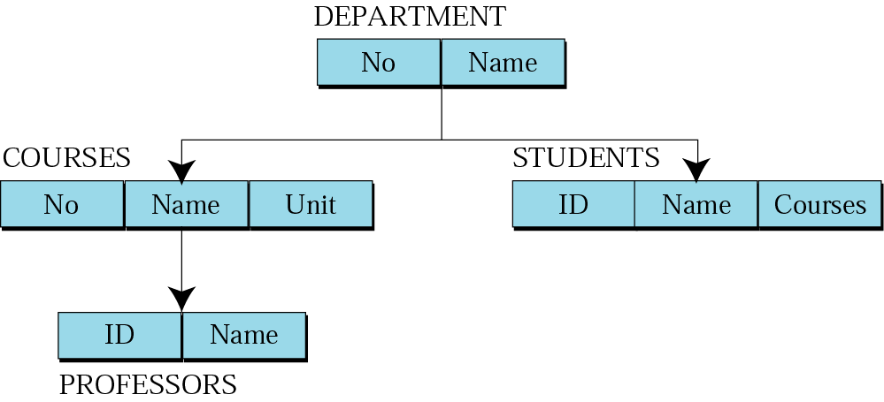
Hierarchical model
Data are organized in an upside down tree
Each entity has one parent and many children
Old and not used now

Slide 5
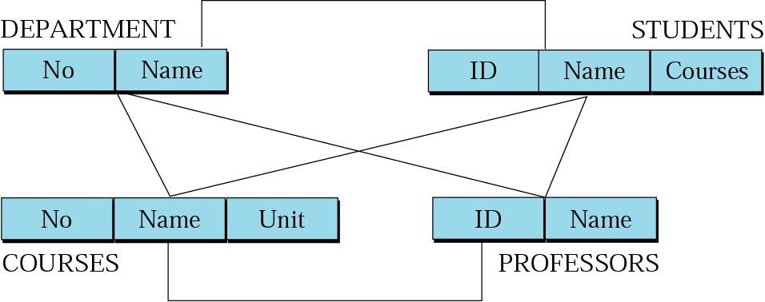
Network model
Entities are organized in a graph
Entities can be accessed through several paths
Old and not used

Slide 6
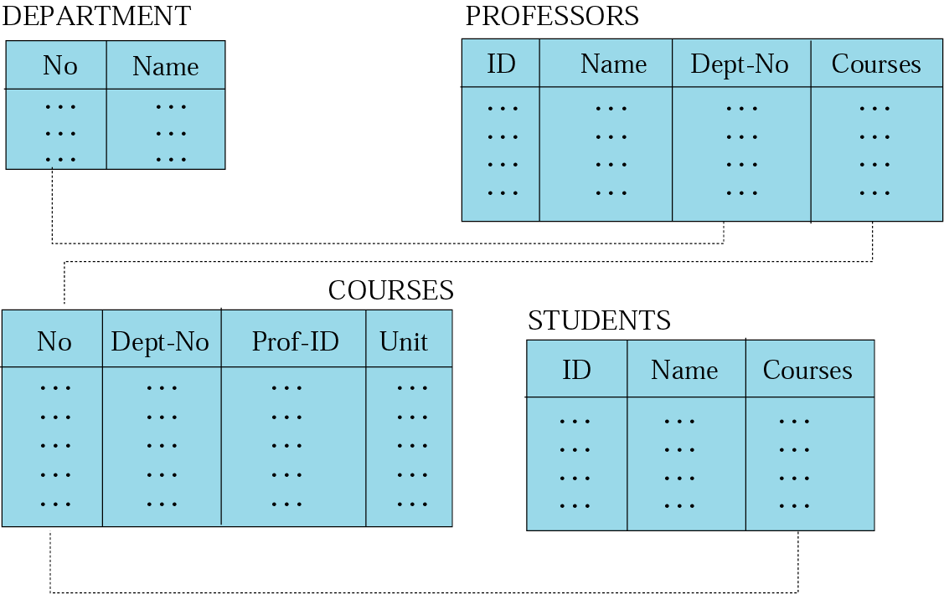
Relational model
Data are organized in two dimensional tables (relations)
Tables re related to each other
Relational Database Management System (RDBMS) are more common model used today

Slide 7
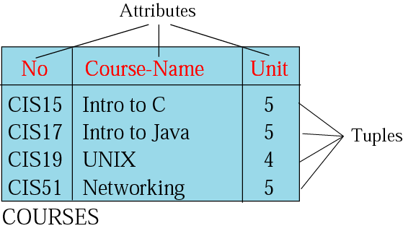
Relation (Name, Attributes, Tuples)
Attributes are the column heading
Each column must have a unique heading
Number of columns is called the degree of the relation
Tuple is a collection of attribute value
Total number of rows is called Cardinality of the relation
Each relation must have a unique name
Name
Relation appears in 2 dimensional table
That doesn’t mean data stored as table; the physical storage of data is independent of the logical organization of data

Slide 8
OPERATIONS
ON
RELATIONS

Slide 9
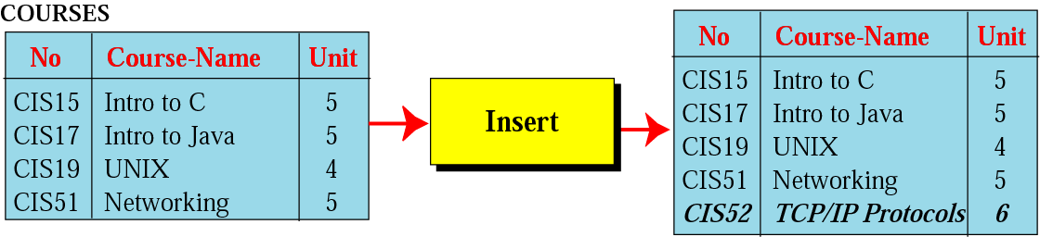
Insert operation
Unary operation
Insert Operation: Inserts new tuple into the relation

Slide 10
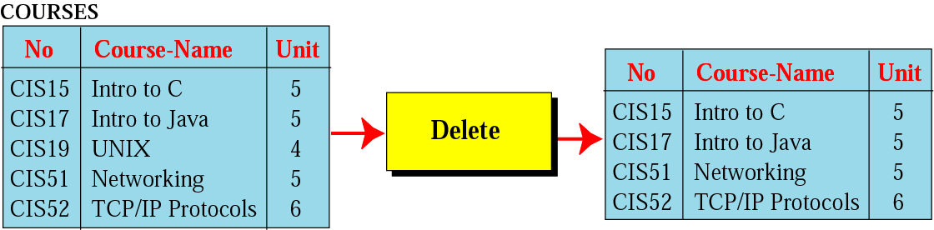
Delete operation
Unary operation
Delete Operation: Deletes tuple from the relation

Slide 11
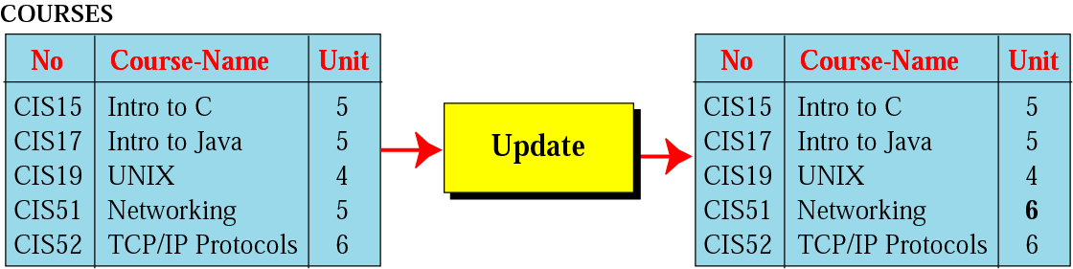
Update operation
Unary operation
Update Operation: Changes the values of some attributes of a tuple

Slide 12
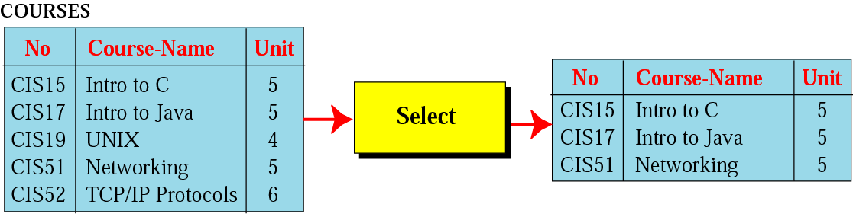
Select operation
Unary operation
Select Operation: Uses some criteria to select some tuples from the original relation

Slide 13
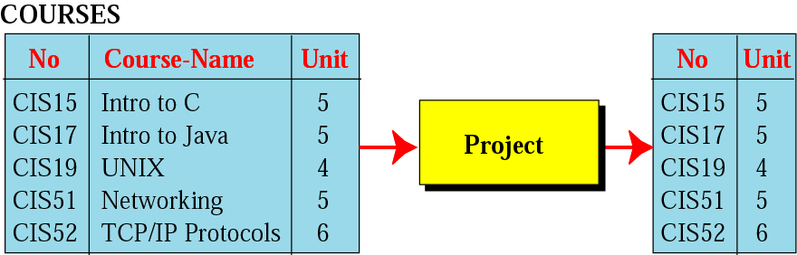
Project operation
Unary operation
Project Operation: Creates relation in which each tuple has fewer attributes

Slide 14
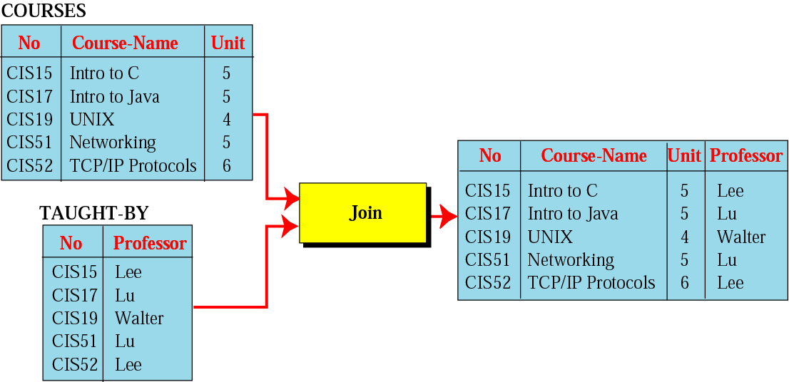
Join operation
Binary operation
Join Operation: Takes two relation and combine them based on common attribute

Slide 15
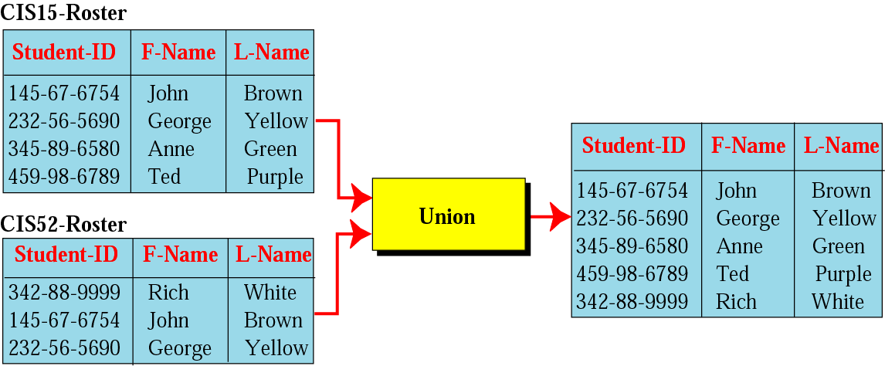
Union operation
Binary operation
Union Operation: Creates new relation in which each tuple is either in the first relation, the second relation or in both

Slide 16
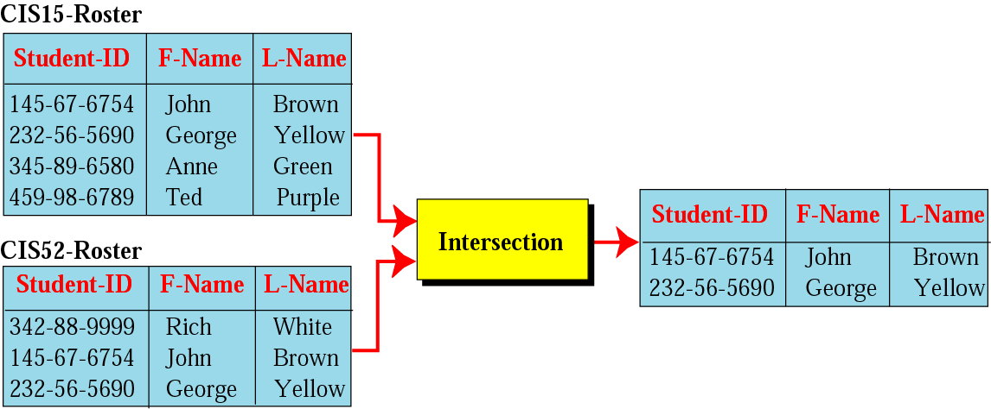
Intersection operation
Binary operation
Intersection Operation: Creates new relation in which each tuple is in both relations.

Slide 17
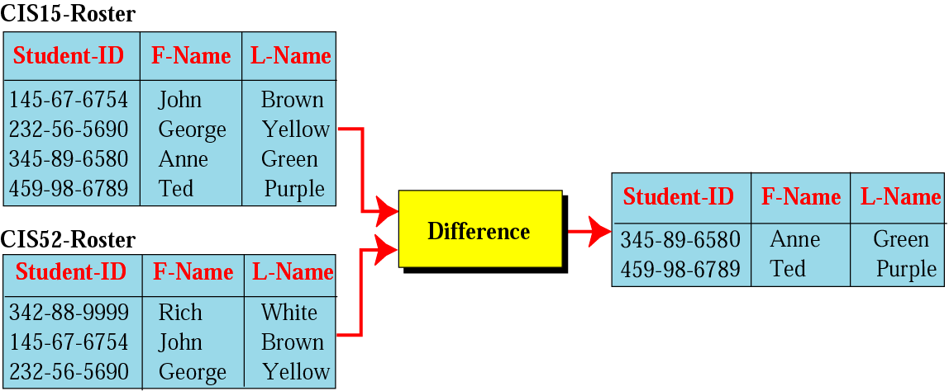
Difference operation
Binary Operation
Difference Operation: Creates new relation where the new tuples are in the first relation but not in the second.

Slide 18
Database Management System
A database management system (DBMS) is system software for creating and managing Database.
The DBMS provides users and programmers with a systematic way to create, retrieve, update and manage data.
DBMS allow all the operations on database discussed in previous slides
  Inserte, Delete, retrieve, Union, Join etc…

Slide 19
STRUCTURED
QUERY
LANGUAGE

Slide 20
SQL
SQL is the standard language used for relational databases.
It is declarative language where users declare what they want without having to write a step by stem procedure.
It was first implemented by Oracle Corporation

Slide 21
1. Insert
SQL Insert Operation format
insert into RELATION-NAME
values (…, …, …)

Slide 22
Insert (Example)
insert into COURSES
values (“CIS52”, “TCP/IP Protocols”, 6)

Slide 23
2. Delete
SQL Delete Operation format
delete from RELATION-NAME
where criteria

Slide 24
Delete (Example)
Delete from COURSES
where No = “CIS19”

Slide 25
3. Update
SQL Update Operation format
update RELATION-NAME
set attribute1 = value1 attribute 2 = value2 …
where criteria

Slide 26
Update (Example)
update COURSES
set unit = 6
where No = “CIS51”

Slide 27
4. Select
SQL Select Operation format
select *
from RELATION-NAME
where criteria

Slide 28
Select (Example)
select *
from COURSES
where Unit = 5

Slide 29
5. Project
SQL Project Operation format
select attribute-list
from RELATION-NAME

Slide 30
Project (Example)
select No, Unit
from COURSES

Slide 31
6. Join
SQL Join Operation format
select attribute-list
from RELATION NO1, RELATION NO2
where criteria

Slide 32
Join (Example)
select No, Course-Name, Unit, Professor
from COURSES, TAUGHT-BY
where COURSES.No = TAUGHT-BY.No;

Slide 33
7. Union
SQL Union Operation format
select *
from RELATION NO1
union
select *
from RELATION NO2

Slide 34
Union (Example)
select *
from CIS15-Roster
union
select *
from CIS52-Roster;

Slide 35
8. Intersection
SQL Intersection Operation format
select *
from RELATION NO1
intersection
select *
from RELATION NO2

Slide 36
Intersection (Example)
select *
from CIS15-Roster
intersection
select *
from CIS52-Roster;

Slide 37
9. Difference
SQL Difference Operation format
select *
from RELATION NO1
minus
select *
from RELATION NO2

Slide 38
Intersection (Example)
select *
from CIS15-Roster
minus
select *
from CIS52-Roster;

Slide 39
OTHER
DATABASE
MODELS

Slide 40
The levels of Data
Database | One or more tables
Table (relation) | A collection of Records
Record | A group of related fields
Field | One or more character
Character | At least 8 bits
Bit | 0 or 1

Slide 41
5 characteristics of Good Database
Data Integrity | Ensuring data is valid
Data Independence | Data is separated from software
Avoiding data Redundancy | Repetition of input data is avoided
Data Security | Data is not accessible to unauthorized users
Data Maintenance | Set procedures for adding ,deleting … records for the purpose of optimization

Slide 42
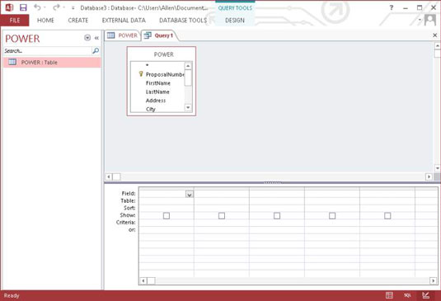
How To Write And Run SQL Query
Open your database and click the CREATE tab.
  This will display the ribbon across the top of the window.
Click Query Design in the Queries section.
  The Show Table dialog box appears.
Select the POWER table. Click the Add button and then click the Close button to close the dialog box.

Slide 43
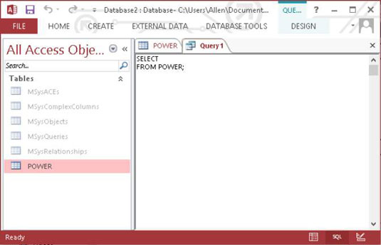
How To Write And Run SQL Query
Click the Home tab and then the View icon in the left corner of the Ribbon.
  A menu drops down, displaying the different views available to you in query mode. One of those views is SQL View.
Click SQL View to display the SQL View Object tab.

Slide 44
How To Write And Run SQL Query
Fill in an asterisk (*) in the blank area in the first line and add a WHERE clause after the FROM line.
  If you had already entered some data into the POWER table, you could make a retrieval with something like:
  SELECT * FROM POWER WHERE LastName = 'Marx' ;
Enter a name and then click OK.
  Your statement is saved and can be executed as a query later.

